Slide 1
Correlation Testing
Marshall Smith, Adrian College, Foundations of Data Analytics 2, Dr. Sabasi, 4/20/24

Slide 2
Background
Analyzed correlation of real-world statistics
This research informs policy, resource allocation, and interventions to reduce crime and improve public health.
Notes:
Good evening, everyone.
Today, I'll be presenting my research on the correlation between median household income and homicide rate, as well as the impact of homicide rate on life expectancy, state by state.
Firstly, I set out to explore whether there's a relationship between median household income and homicide rate across different states. I gathered data on these variables and conducted a thorough analysis to understand any potential correlations.
Secondly, I delved into investigating whether homicide rates have any influence on life expectancy at the state level. This aspect of the research aimed to uncover any potential effects of crime rates on public health outcomes.
Throughout my analysis, I employed statistical techniques to examine these relationships, seeking to provide valuable insights into public policy decisions, resource allocation, and intervention strategies aimed at reducing crime and improving public health outcomes at the state level.

Slide 3
Hypothesis
Q1 Null Hypothesis: There is no relationship between median household income and homicide rate
Q1 Alternative Hypothesis: There is a relationship between median household income and homicide rate
Q2 Null Hypothesis: There is not a significant relationship between life expectancy at birth and homicide rate
Q2 Alternative Hypothesis: There is a significant relationship between life expectancy at birth and homicide rate
Notes:
For my first question,
I formulated the null hypothesis that there is no relationship between median household income and homicide rate.
- assume this bc we are searching for evidence that there is a correlation between these two variables
Conversely, the alternative hypothesis suggests that such a relationship does exist.
-This would be the opposite and would be the result if we found correlation
Moving on to my second question,
I established the null hypothesis that there is not a significant relationship between life expectancy at birth and homicide rate.
-assume this bc we are searching for evidence that there is a correlation between these two variables
Conversely, the alternative hypothesis suggests that there is indeed a significant relationship between these two variables.
-This would be the opposite and would be the result if we found correlation
Null: assume this bc we are searching for evidence that there is a correlation between med income and hom. Rate
Alter: This would be the opposite and would be the result if we found correlation
Null: assume this bc we are searching for evidence that there is a correlation between hom rate and life expectancy

Slide 4
Research Methodologies
Correlation Analysis
Inferential Analysis
Comparative Analysis
A/B Testing
Simulation Analysis
Notes:
Most importantly,
I utilized correlation analysis,
which aims to examine the relationship between multiple variables without manipulating them.
This method allowed me to summarize my findings and describe the main features of the dataset,
such as calculating means and medians of the data.
Next,
I employed inferential analysis to draw conclusions and make inferences about the population based on the data.
This involved techniques such as hypothesis testing and implementation of confidence intervals.
Additionally,
I conducted comparison analysis by comparing different groups,
such as states with different median incomes,
homicide rates, and life expectancy.
This allowed me to assess similarities and differences between these groups.
To facilitate comparison analysis,
I utilized A/B testing,
which helped me compare the groups and determine if there is significance between the variables.
Finally,
I employed simulation analysis to simulate comparisons to ensure accurate p-values reflecting the true correlation.
This comprehensive approach allowed me to thoroughly analyze the relationships between the variables under study.
MAIN Method: Correlation Analy
Aims to examine the relationship between multiple variables without manipulating them
Descript. Analy.
Summarize my findings & describe main features of the dataset
Ex of how it was used) calculating means and medians of the data
Inferential Analy.
Utilized to draw conclusions and make inferences about the population based on the data
Also used techniques such as hypothesis testing and implementation of confidence intervals
Comparison Analysis
Did it by comparing different groups such as states with different median incomes, homicide rates, and life expectancy
Was used to assess similarities and differences between these different groups
A/B Testing
Did this in order to do a good comparison analysis
Helped me compare the groups and determine if there is significance between the variables
Simulation Analy.
I had to simulate the comparisons to ensure I didn’t get a p-value that was not accurate to the true correlation

Slide 5
Data Collection Process
Gathered data from government websites including homicide rate, life expectancy, and median household income.
Obtained homicide and life expectancy data from the CDC’s state-wide statistics page
Used census.gov for median household income data from multiple years
  Focused on 2018 for analysis
Notes:
To begin with,
I collected data
including homicide rate, life expectancy,
and median household income
from various government websites,
For homicide and life expectancy data,
I obtained information from the CDC's state-wide statistics page.
This platform provided comprehensive data for each state,
allowing me to access relevant statistics.
Additionally,
I retrieved median household income data from census.gov,
which contained data from multiple years.
However, for the purpose of my analysis,
I focused specifically on the year 2018 to ensure consistency and accuracy in my findings.

Slide 6
Data Preparation
Created a spreadsheet to combine and organize data from different sources
Ensure data consistency and accuracy by filtering out irrelevant information
Cleaned the data to retain only rows with valid numerical data
Notes:
Now,
let's delve into how I managed and prepared the data for analysis.
Firstly,
I created a spreadsheet to consolidate and organize data from various sources.
This allowed me to streamline the data collection process and maintain consistency throughout.
Next,
I meticulously filtered out any irrelevant information to ensure that only pertinent data was retained for analysis.
This step was crucial in maintaining data accuracy and relevance to my research questions.
Finally,
I conducted data cleaning procedures to eliminate any inconsistencies or anomalies.
This involved retaining only rows with valid numerical data,
which helped in minimizing errors and ensuring the integrity of my analysis.
I did this for “Median Household income” and “homicide rate”

Slide 7
Data Cleaning Process
Manipulated the data to handle missing values (NaN) using Python
Utilized the ‘np.isnan()’ function to identify NaN values
This helped me to filter out rows with missing data, which ensured data integrity for analysis
Notes:
let's explore how I managed missing values in the dataset using Python.
To handle missing values,
I employed Python programming techniques to effectively identify and manage NaN values.
Specifically,
I utilized the 'np.isnan()' function from Python’s ‘numpy’ module to detect these missing values within the dataset.
By identifying NaN (not a number) values,
I was able to filter out rows containing missing data,
thereby ensuring the integrity and reliability of the dataset for further analysis.
This meticulous approach helped in maintaining data quality and accuracy throughout the research process.
NaN: NOT A NUMBER
*Np comes from the numpy module in python

Slide 8
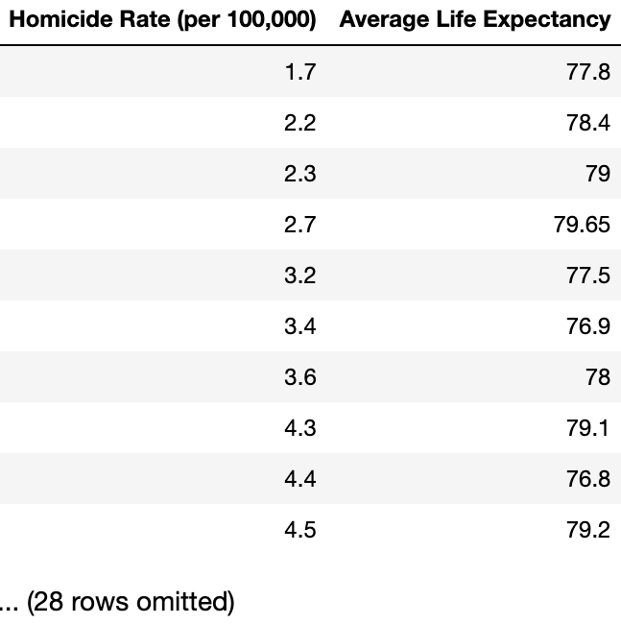
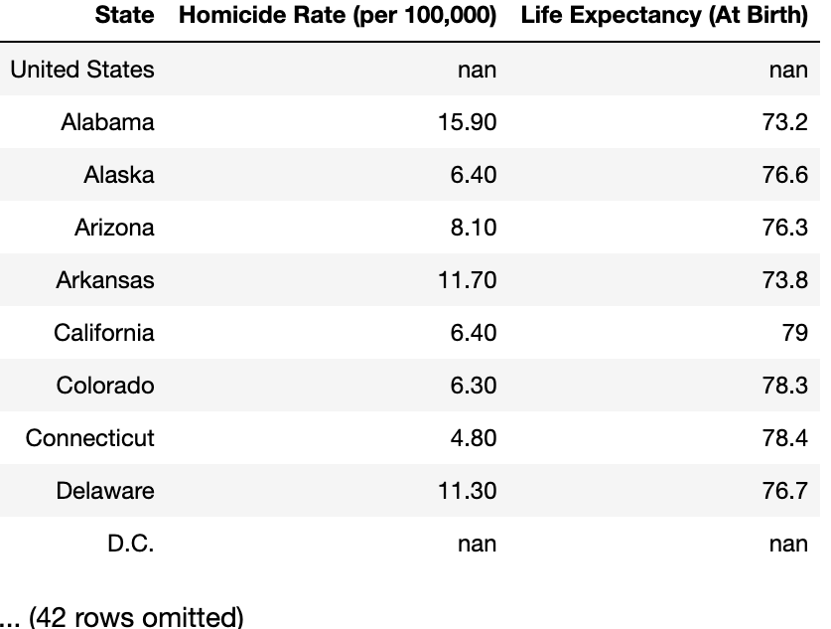
Data Overview
Figure2
Figure 1
Notes:
In Figure 1,
we have the original dataset displaying life expectancy and homicide rates in their raw form,
before any cleaning procedures were undertaken.
This dataset serves as a reference point to illustrate the initial state of the data and elucidate the necessity for data cleaning.
Moving on to Figure 2,
we observe a dataset depicting the average life expectancy corresponding to different homicide rates.
Utilizing 'rate_mean,’
I derived this dataset to offer insights into the variations in average life expectancy across various homicide rates.
Such insights are valuable for exploring potential correlations or patterns between homicide rates and life expectancy,
enabling a deeper understanding of their relationship.
Figure 1
Shows the original data set with Life expectancy and homicide rate
This dataset is before I cleaned the data
Showed this so that I could show the original data and why I needed to clean it
Figure 2
This dataset shows the average life expectancy per homicide rate
I used ‘rate_mean’ to provide insights into how average life expectancy varies across different homicide rates
This can be useful for analyzing potential correlations or patterns between homicide rates and life expectancy

Slide 9
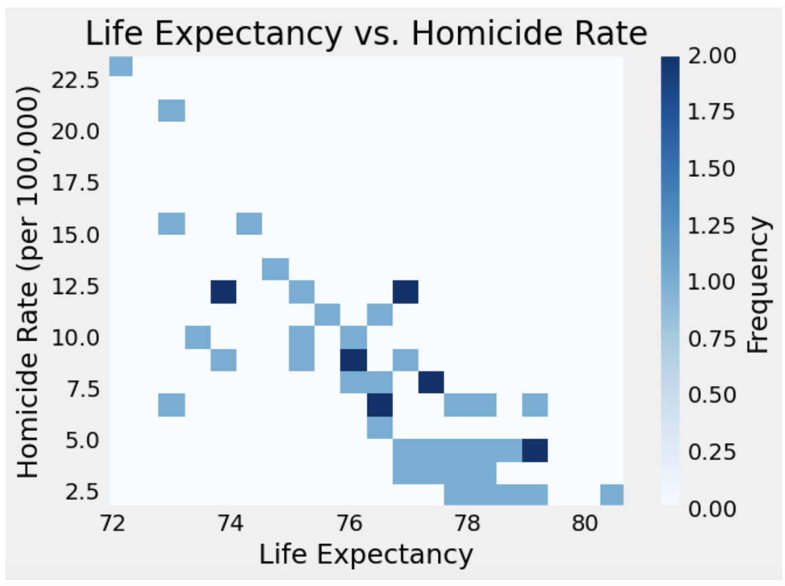
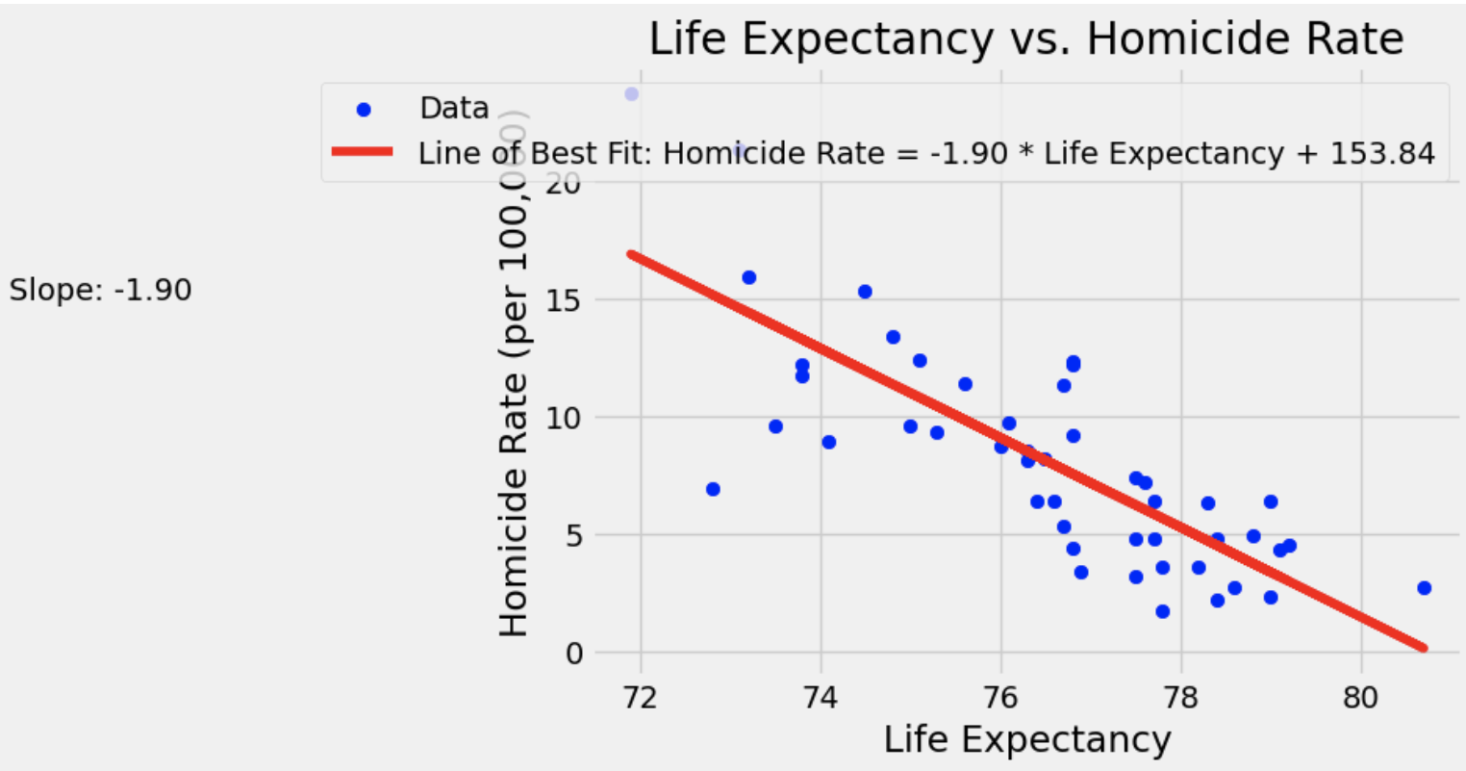
Data Overview
Figure 3
Figure 4
Notes:
In Figure 3,
we have a histogram comparing homicide rates and life expectancy,
where homicide rate is plotted on the y-axis and life expectancy on the x-axis.
This visualization offers insights into how homicide rates impact life expectancy.
The darker bins represent a higher concentration of data points within that bin.
Upon initial observation,
the histogram suggests a moderate correlation between life expectancy and homicide rate, with a negative correlation implying that higher homicide rates are associated with lower life expectancy.
Transitioning to Figure 4,
we observe a histogram featuring a line of best fit.
The downward slope of the line reaffirms our hypothesis of a moderate negative correlation between homicide rate and life expectancy.
It suggests that as life expectancy increases,
homicide rate decreases.
The steepness of the slope serves as an indicator of correlation strength,
with steeper slopes indicating stronger correlations.
In this case,
the slope of -1.9 suggests a moderate to weak correlation between homicide rate and life expectancy.
Figure 3
This shows a histogram that compares homicide rates and life expectancy
Homicide rate is on the y-axis
Life expectancy is the x-axis
This histogram gives us a good look at how homicide rates affect the life expectancy
The darker bins signify more data points within that bin
At first glance the histogram seems to show a moderate correlation between life expectancy and homicide rate
The correlation appears to be negative meaning: the higher the homicide rate the lower the life expectancy
Figure 4
This histogram shows a line of best fit
Line of best fit slopes downwards which reaffirms our theory that there is a moderate negative correlation between homicide rate and life expectancy
Indicates as life expectancy increases, homicide rate decreases
Steepness of the slope is telling
Steeper indicates more correlation
This slope is -1.9 which only indicates moderate to weak correlation

Slide 10
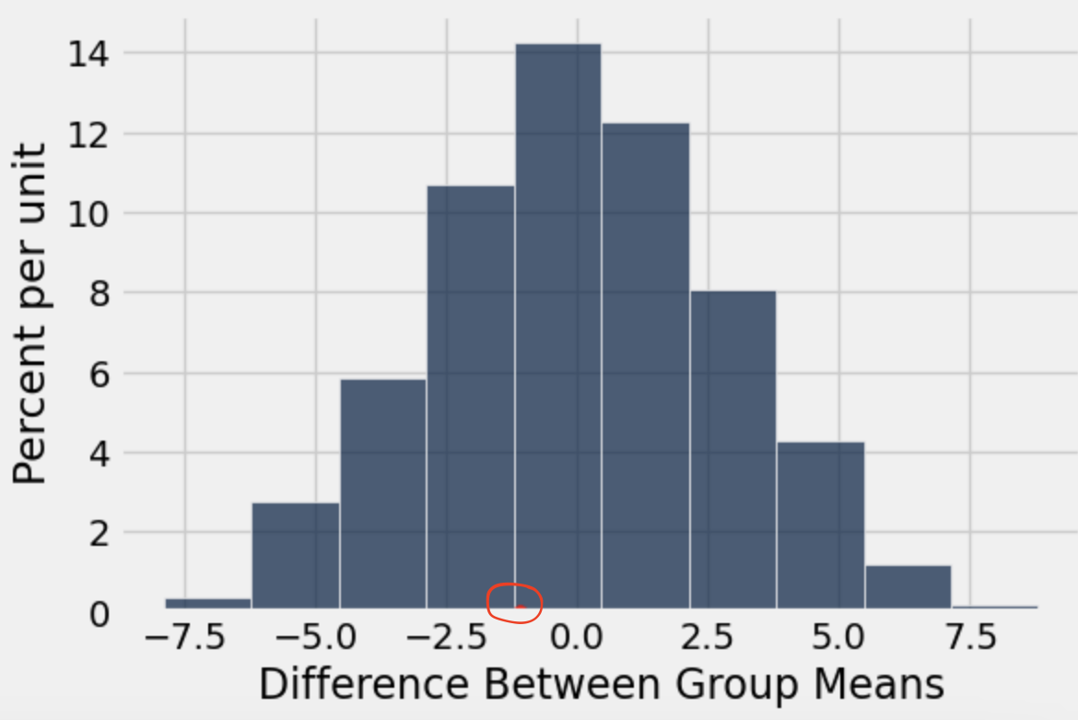

Data Overview
Figure 5
Notes:
In this histogram,
we aimed to evaluate the distribution of differences between group means.
Each bar represents a range of differences,
with the height indicating the frequency of observations falling within that range.
If the histogram displays a symmetric non-random pattern,
it suggests that the differences between group means occur by random chance,
indicating a lack of statistical significance.
Additionally,
you'll notice a red dot within the histogram,
representing the observed difference between group means.
If the dot is positioned farther out on the tails of the histogram,
it suggests a higher degree of correlation beyond random chance.
However, in this case, the dot appears near the middle,
indicating that the observed difference is more typical and may not be statistically significant.
Created this histogram
To assess and visualize the distribution of differences between those group means
Each bar represents a range of differences and the height of each bar indicates frequency of observations falling within that range of differences
If it is organized in a symmetric non-random pattern
Would indicate the differences per group are by random chance
That means they would not be statistically significant
Also contains red dot
Represents the observed difference between group means
If the dot is farther out on the tails, that would indicate there is more correlation than just random chance
In this case: the dot is near the middle which means the observed difference is more typical and may not be statistically significant

Slide 11
Hypothesis Testing
Used a Frequentist approach
Question 1:
  Categorized states into two groups based on Median Income
  Gathered a test statistic
  Made a p-value determination using a permutation test and bootstrap test
Question 2:
  Categorized states into two groups based on Homicide rates
  Gathered a test statistic
  Made a p-value determination using the same tests
Notes:
In our analysis,
we adopted a Frequentist approach to address two primary questions.
This approach relies on p-values for statistical inferences instead of incorporating prior knowledge about parameters being estimated
Firstly,
we categorized states into two groups based on Median Income and gathered a test statistic to evaluate the relationship.
This test statistic observed the difference in average homicide rate between states with median incomes above $50,000 and those below or equal to $50,000
We then determined the p-value using both permutation and bootstrap tests.
Similarly, for our second question,
we categorized states based on Homicide rates,
collected a test statistic
and performed p-value determination using the same tests.
This test statistic observed difference in life expectancy between states with a homicide rate above 5 and those below or equal to 5
The permutation test was instrumental in comparing group means and assessing relationships between variables like median income and homicide rate.
Meanwhile, the bootstrap test helped us gauge the variability of statistics,
with a specific focus on means.
Freq. Appr: relied on p-values for statistical inferences, not incorporating prior knowledge about parameters being estimated
- Q1:
Two groups: above $50,000 and below or equal to $50,000
Test Statistic: observed difference in average homicide rate between states with median incomes above $50,000 and those below or equal to $50,000
Q2:
Two Groups: above 5 and below or equal to 5
Test Statistic: observed difference in life expectancy between states with a homicide rate above 5 and those below or equal to 5
Permutation test: to compare group means and assess the relationship between variables like median income and homicide rate
Bootstrap test: used to gauge the variability of statistics, focusing on means

Slide 12
Interpretation of the Results
Question 1
  P-value: 0.9812
  Failed to reject null hypothesis
  The high p-value suggests that any observed correlation may be due to chance or other unaccounted factors influencing homicide rates
Question 2
  P-value: 0.6564
  Failed to reject null hypothesis
  A p-value of 0.65 suggests that in 65% of simulated trials, observed differences between groups occurred by random chance alone
Notes:
For our first inquiry,
the correlation between median household income and homicide rates per state produced a p-value of 0.9812.
Given a 5% p-value cutoff,
we failed to reject the null hypothesis.
This suggests there's no direct correlation between poverty level and homicide rates.
Moving to our second question,
the correlation between homicide rates and life expectancy per state resulted in a p-value of 0.6564.
Once again, we failed to reject the null hypothesis at a 5% p-value cutoff.
This indicates no direct correlation between homicide rates and life expectancy.
Q1:
Correlation between median household income and homicide rates per state yielded a p-value of 0.9812
Failure to Reject Null Hypothesis: At a 5% p-value cutoff, we fail to reject the null hypothesis, indicating no direct correlation between poverty level and homicide rates
Q2:
Correlation between homicide rates and life expectancy per state resulted in a p-value of 0.6564
Failure to reject: Using a 5% p-value cutoff, we fail to reject the null hypothesis, indicating no direct correlation between homicide rates and life expectancy

Slide 13
Conclusion
Determined research objectives
Employed statistical
Determined Significance
Found no statistical significance
Failed to reject the null hypothesis which means there is no evidence supporting alternative hypothesis proposed
Notes:
Research Objectives:
We set out to investigate the relationship between median income and homicide rate,
as well as the impact of homicide rate on life expectancy at birth.
Statistical Techniques:
To achieve our objectives, we employed hypothesis testing, correlation analysis,
and linear regression.
Significance:
Our research aims to inform public policy decisions, resource allocation,
and intervention strategies aimed at reducing crime and improving public health outcomes.
Findings:
Our analysis revealed no statistically significant association between median income and homicide rate.
Additionally,
we found that higher homicide rates do not correlate with lower life expectancy.
Conclusion:
Based on our analysis, we failed to reject the null hypothesis,
concluding that there is no evidence supporting the alternative hypothesis proposed in our study.
Research Objectives:
Investigated relationship between median income and homicide rate
Explored impact of homicide rate on life expectancy at birth
Stat. Tech:
Utilized hypothesis testing, correlation analysis, and linear regression
Significance:
Informing public policy decisions, resource allocation, and intervention strategies
Aimed at reducing crime and improving public health outcomes
Findings:
No statistically significant association found between median income and homicide rate
Higher homicide rates do not correlate to lower life expectancy
Conclusion:
Failed to reject null hypothesis
Concluded no evidence supporting alternative hypothesis proposed in the study

Slide 14
References
Centers for Disease Control and Prevention. (2022, March 2). Stats of the States - Homicide Mortality. Centers for Disease Control and Prevention. https://www.cdc.gov/nchs/pressroom/sosmap/homicide_mortality/homicide.htm
Table H-8. median household income by State. Census.gov. (n.d.). https://www2.census.gov/programs-surveys/cps/tables/time-series/historical-income-households/h08.xls

